Slide 1
Renewable Energy Generation and Dependency in Singapore
ANL488 Oral Presentation
Low Pei Xuan
H2081499
Supervisor: Dr Munish Kumar

Slide 2
Table Of Contents
1 | Introduction
2 | Business Problem & Business Analytics Problem
3 | Related Works
4 | Data Understanding & Data Preparation
5 | Models Used & Evaluation
6 | Modelling Results
7 | Conclusion & Recommendations

Slide 3
1
Introduction

Slide 4









What are Renewable Energies?
Renewables
Non-Renewables
Sources that can be replenished at the rate its used.
Sources that cannot be replenished in our lifetime.
Solar
Hydropower
Biomass
Oil & Petroleum
Coal
Wind
Geothermal
Nuclear
Natural Gas
Notes:
https://www.adtsolar.com/renewable-energy/renewable-vs-non-renewable-energy-sources/#geothermal

Slide 5
Singapore’s Energy Journey

Slide 6


Challenges in renewable energy generation
No river with fast moving waters
Narrow tidal range, calm seas
Sea area used mainly for ports, anchorage and shipping lanes
Hydropower
Land scarcity
Limited land to sustainably grow domestic biomass
Solar
Biomass
Singapore has a high annual solar irradiation. This makes Solar the only possible renewable energy source that Singapore can leverage on and harness.
Commercial wind turbines need wind speed of 4.5m/s
Singapore’s average wind speed is only 2m/s
Wind
No near-surface geothermal energy sources available in Singapore
Geothermal
Notes:
https://www.nccs.gov.sg/singapores-climate-action/singapore-approach-to-alternative-energy/#:~:text=However%2C%20we%20face%20challenges%20to,poses%20challenges%20such%20as%20intermittency.

Slide 7
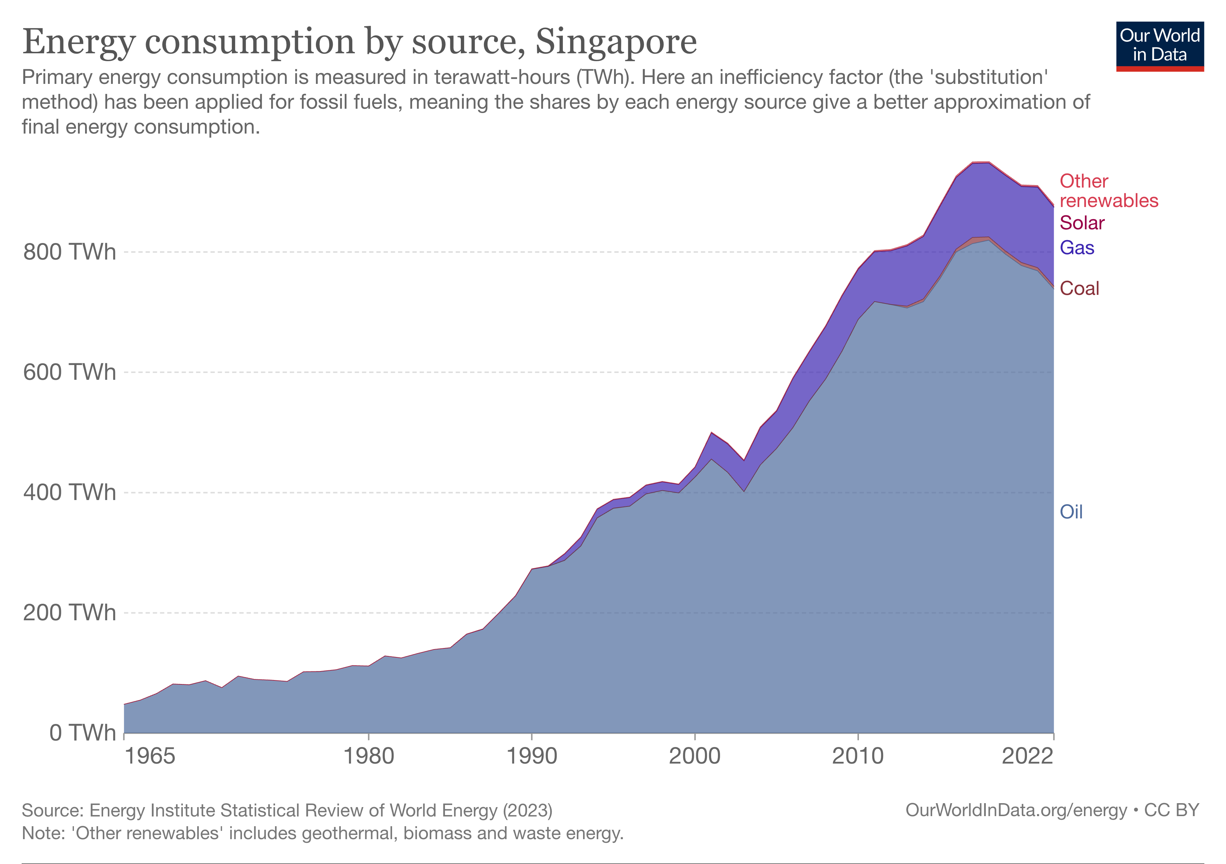
Singapore’s Energy Consumption
0.36%
0.20%
14.86%
0.55%
84.06%
Notes:
https://ourworldindata.org/grapher/energy-consumption-by-source-and-country?stackMode=absolute&time=earliest..2022&facet=none&country=~SGP

Slide 8
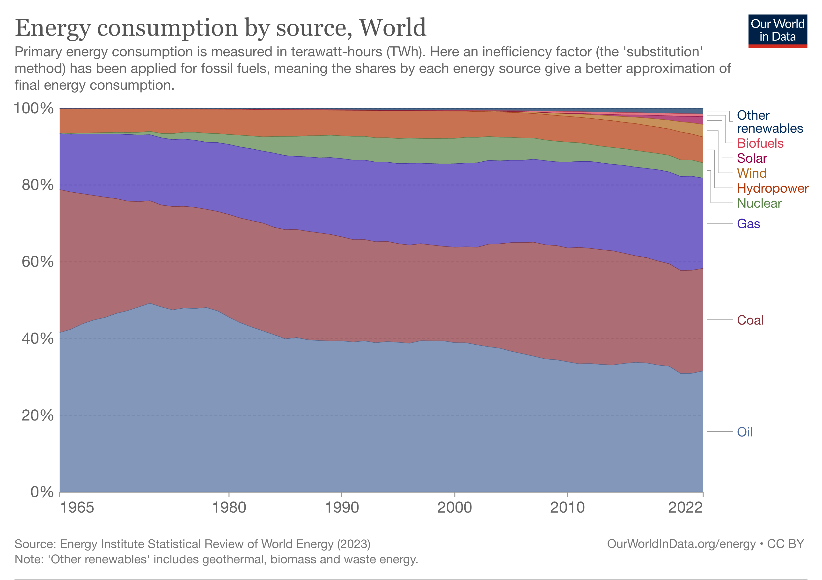
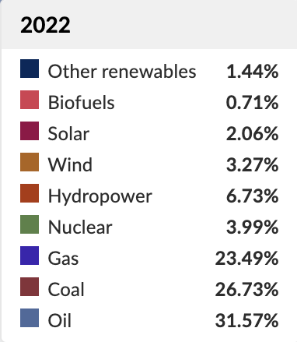
The world’s Energy Consumption
In a highly digitalized world, global energy demand increases with the rate of technology adoption.
Thus, resources are depleting at an alarmingly high rate, urging many more countries to look into alternatives to ensure energy security for the future.
Notes:
https://ourworldindata.org/grapher/energy-consumption-by-source-and-country
Less than 100 years worth of sources left to use
^ 47 years worth of oil left according to Worldometers.info
https://www.worldometers.info/oil/#:~:text=World%20Oil%20Reserves&text=The%20world%20has%20proven%20reserves,levels%20and%20excluding%20unproven%20reserves).

Slide 9
Business Problem & Analytics Problem
2

Slide 10
Business Problem
With high resource depletion rate and electricity security potentially threatened, prediction on Singapore’s renewable electricity generation level, electricity consumption level and population needs to be conducted to deduce if electricity generated through renewable sources domestically will increase in the future to supplement at least 60% of the nation’s electricity consumption level for Singapore to be dependent on it.
Business Analytics Problem
To evaluate which modelling technique is most suitable in deducing Singapore’s dependency on renewable electricity through forecasting techniques applicable to predict Singapore’s electricity consumption, renewable electricity generated and population.

Slide 11
3
Related Works

Slide 12
Regression models
Rekhade, R., & Sakhare, D. K. (2021) conducted a research on sector-wide electricity consumption in India using linear, logarithmic, power and exponential regression models.
Exponential regression model had the best performance.
It was predicted that there will be an exponential increase in electricity consumption of all sectors.
Artificial Neural Network (ANN)
Pannakkong, W., Harncharnchai, T., & Buddhakulsomsiri, J. (2022) forecasted daily electricity consumption level in Thailand using Regression, Artificial Neural Network (ANN), Support Vector Machine, and Hybrid Models.
Hybrid model had the best performance.
Sozen, A. (2009) predicted energy dependency in Turkey using an Artificial Neural Network (ANN) model.
The energy dependency in Turkey was expected to see an increase in the next 14 years.
Time Series Analysis
Manni, U. H., & Datuk. Dr. Kasim Hj. Md. Mansur. (2022) adopted Holt-winters’ test to predict the renewable power capacity and generation in Indonesia.
The renewable energy generation in Indonesia was predicted to be moderate.
Asadi, M., Larki, I., Mohammad, M. F., Ahmadi, R., & Farajollahi, M. (2023) used time series algorithms of ARIMA, single exponential smoothing and Holt to predict electricity consumption, population and CO2 emissions from power plants in Iran.
Iran’s population, electricity consumption and CO2 emission will be expected to increase in the future as well.

Slide 13
Data Understanding & Preparation
4

Slide 14
Datasets Used
Dataset | Variable | Definition | Value | Time Period in Dataset
Electricity_Consumption_Kwh.csv | Electricity Consumption | Amount of electricity consumed measured in Kilowatt-Hour (kWh) | 1,220,000,000 to 24,189,000,000 kWh, N.A. | 1961 to 2022
Electricity_From _Renewables_new.csv | Renewable Electricity Generated | Electricity produced from renewable sources in Kilowatt-hour (kWh) | 85,000,000 to 918,000,000 kWh, N.A. | 1960 to 2022
Total_Population _Column.csv | Singapore’s Population | The number of people residing in Singapore in plain number. | 1,022,100 to 5,637,022 | 1950 to 2022

Slide 15
Data Preparation
Performed these 6 steps to each dataset:
1) Handling missing or null values
2) Check for stationarity
3) Linearize Trend
4) Removing trend
5) Removing Seasonality
6) Ensure stationarity

Slide 16
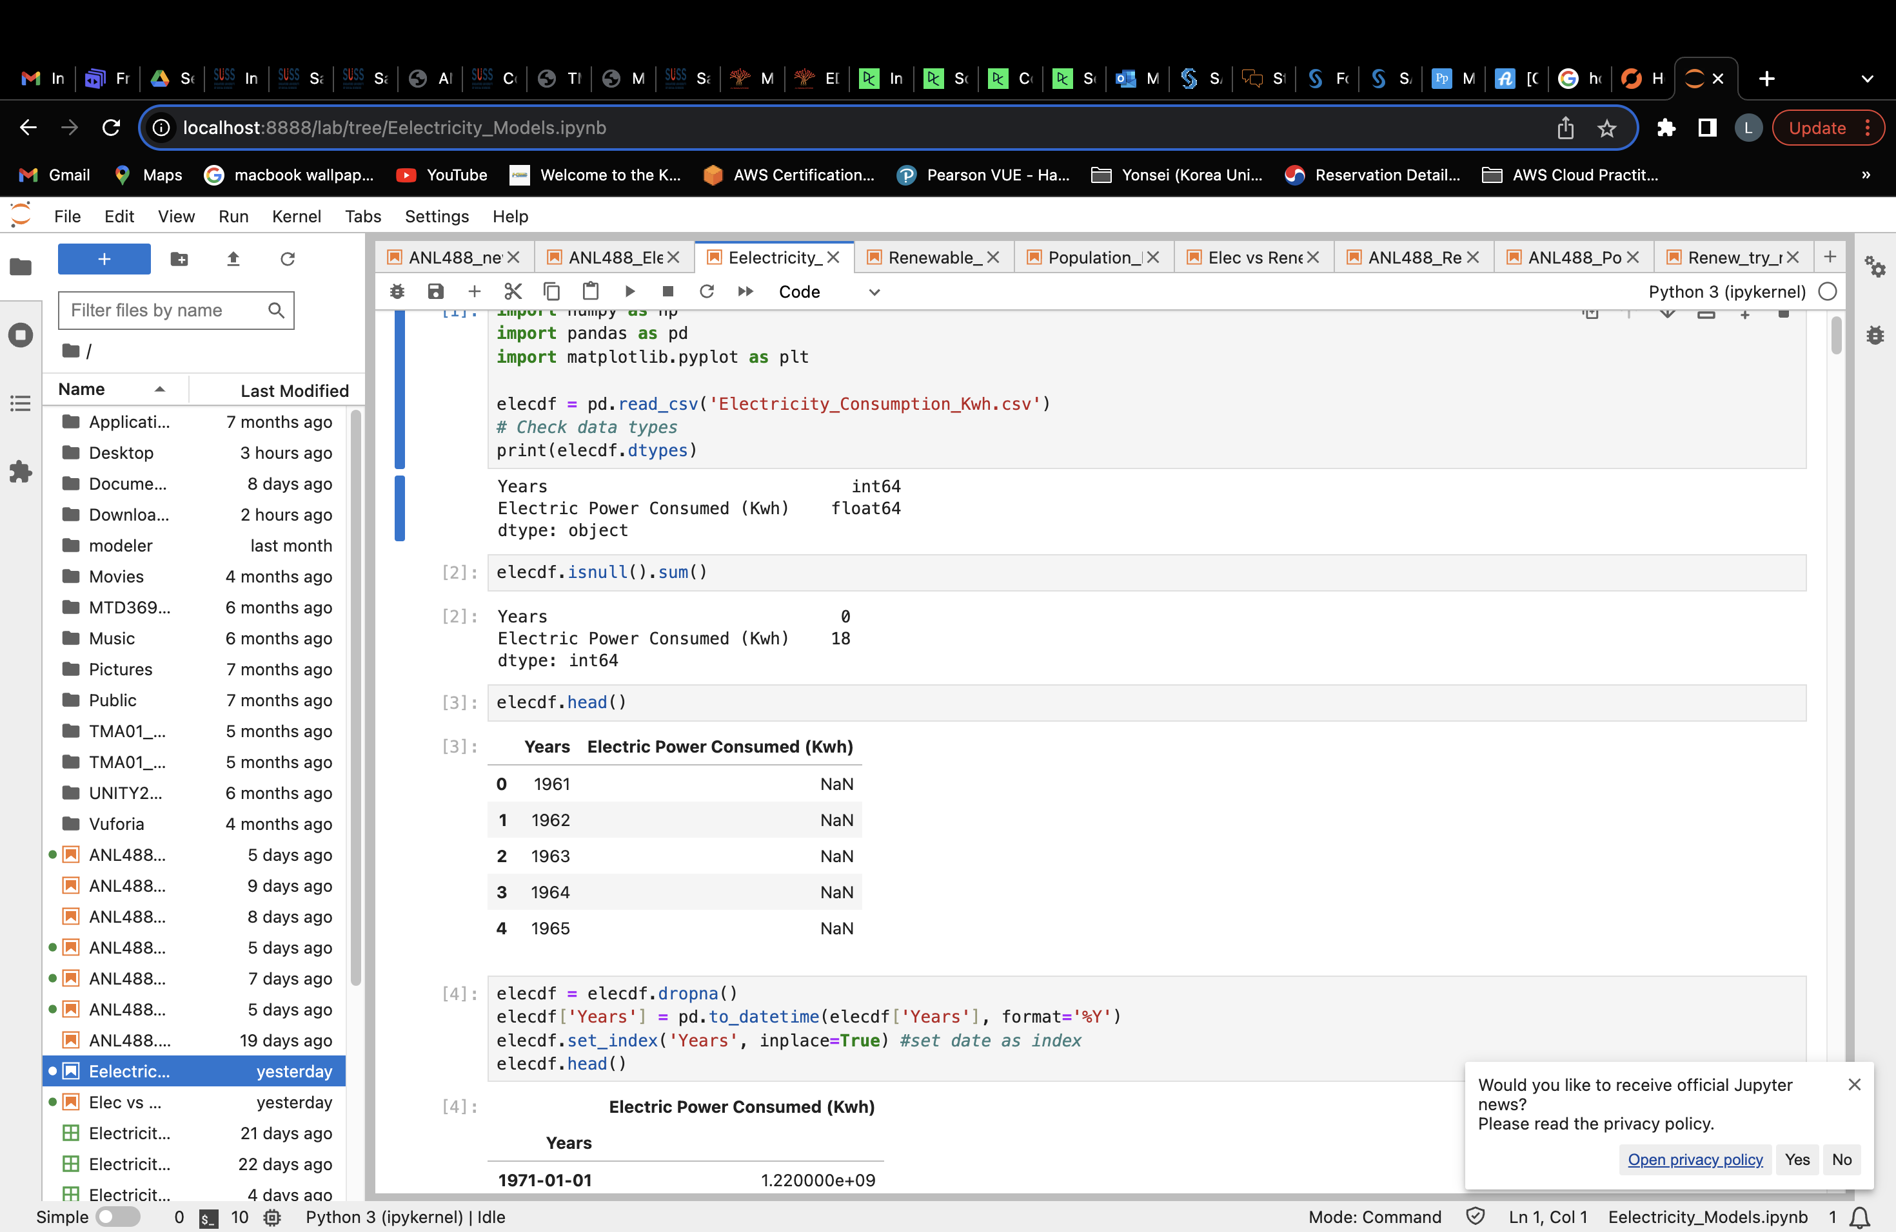
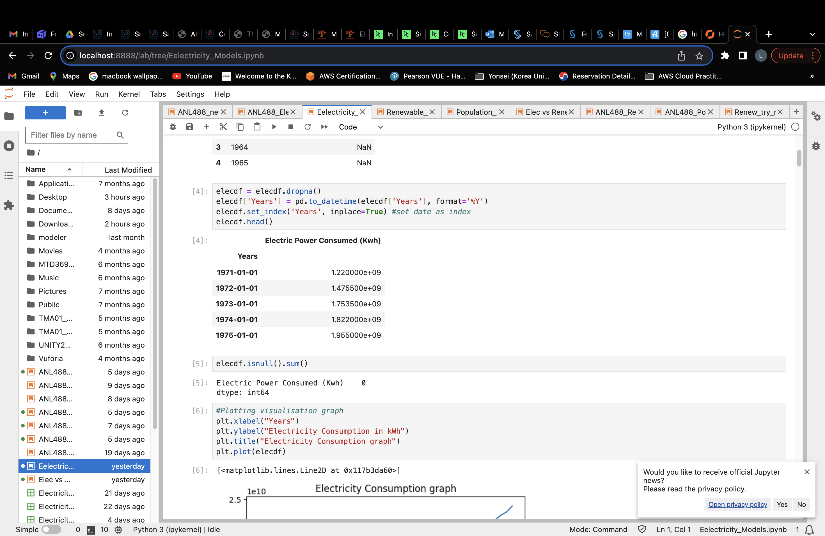
Electricity Consumption Dataset
Handling Missing / Null Values
Discarded 18 Null values, data now ranges from 1971 to 2014.
Before Preparation
After Preparation

Slide 17
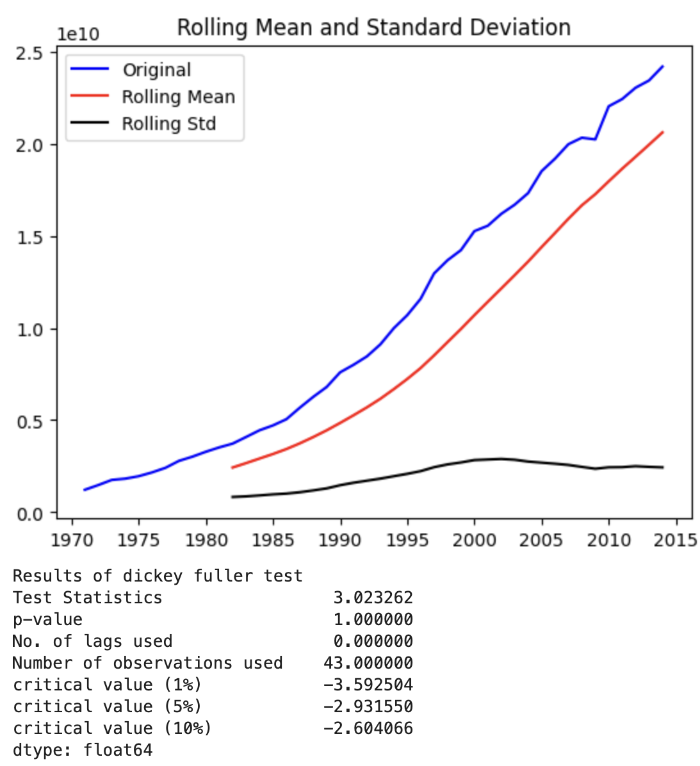
Electricity Consumption Dataset
Check for Stationarity
Augmented Dickey Fuller Test (ADF)
- Null hypothesis (H0): Data is non-stationary
- Reject H0 only if p-value is <= 0.05
Dataset’s Original p-value is 1.00 (2dp) which is more than 0.05
Test Statistics value is > critical values
Hence, Not stationary.

Slide 18
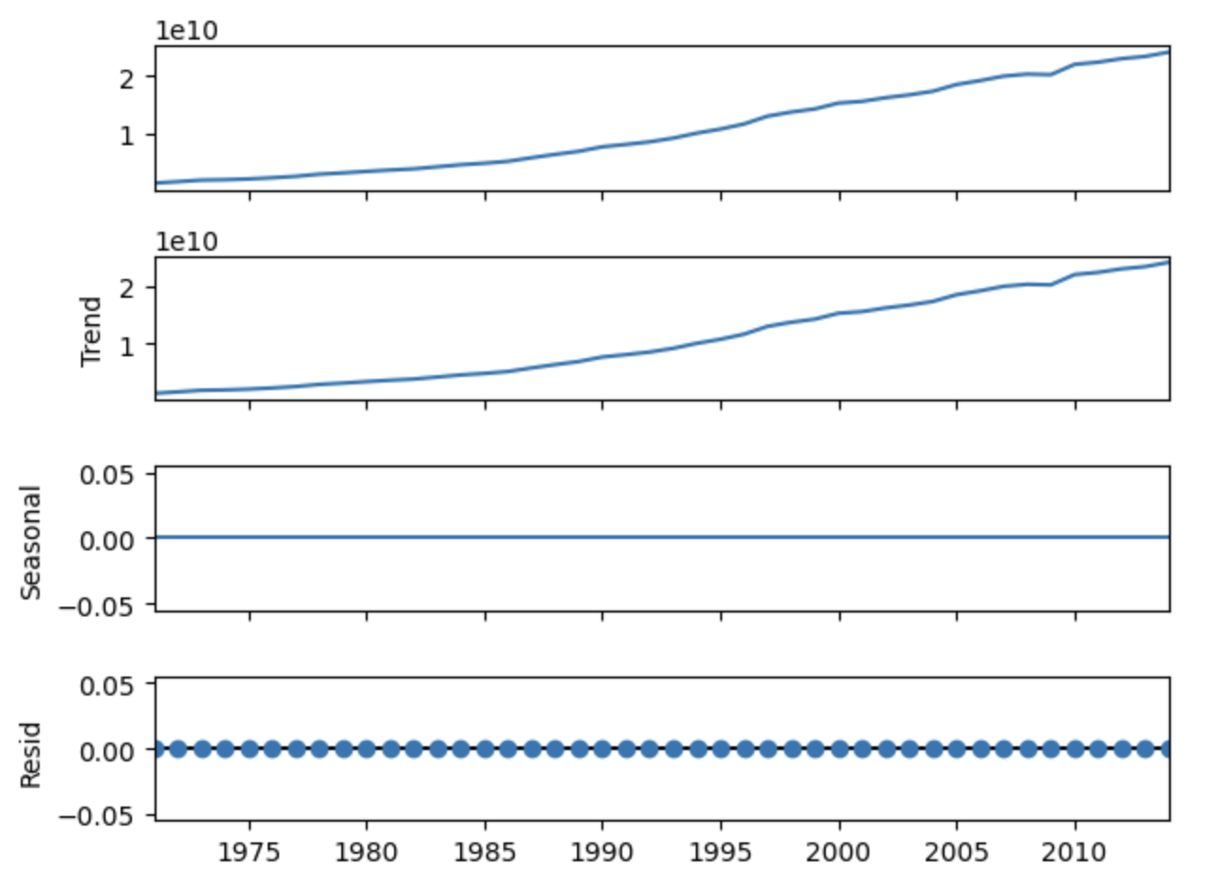
Electricity Consumption Dataset
3) Linearize Trend
Log transformed the dataset values to linearize the trend and decrease dataset value for easier interpretation
4) Removing Trend
A slight upward trend is present

Slide 19
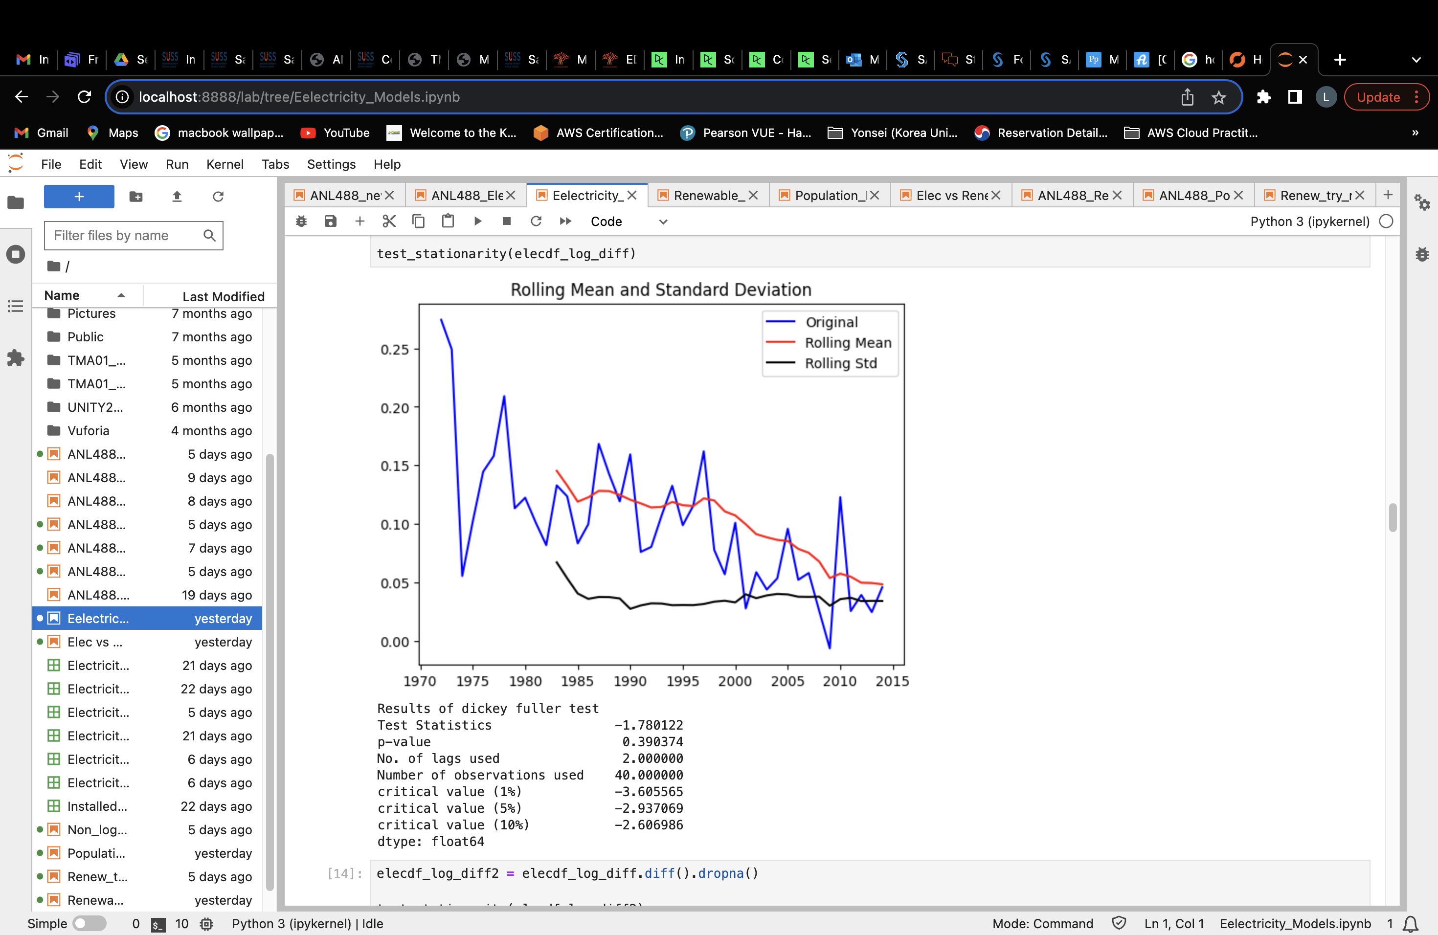
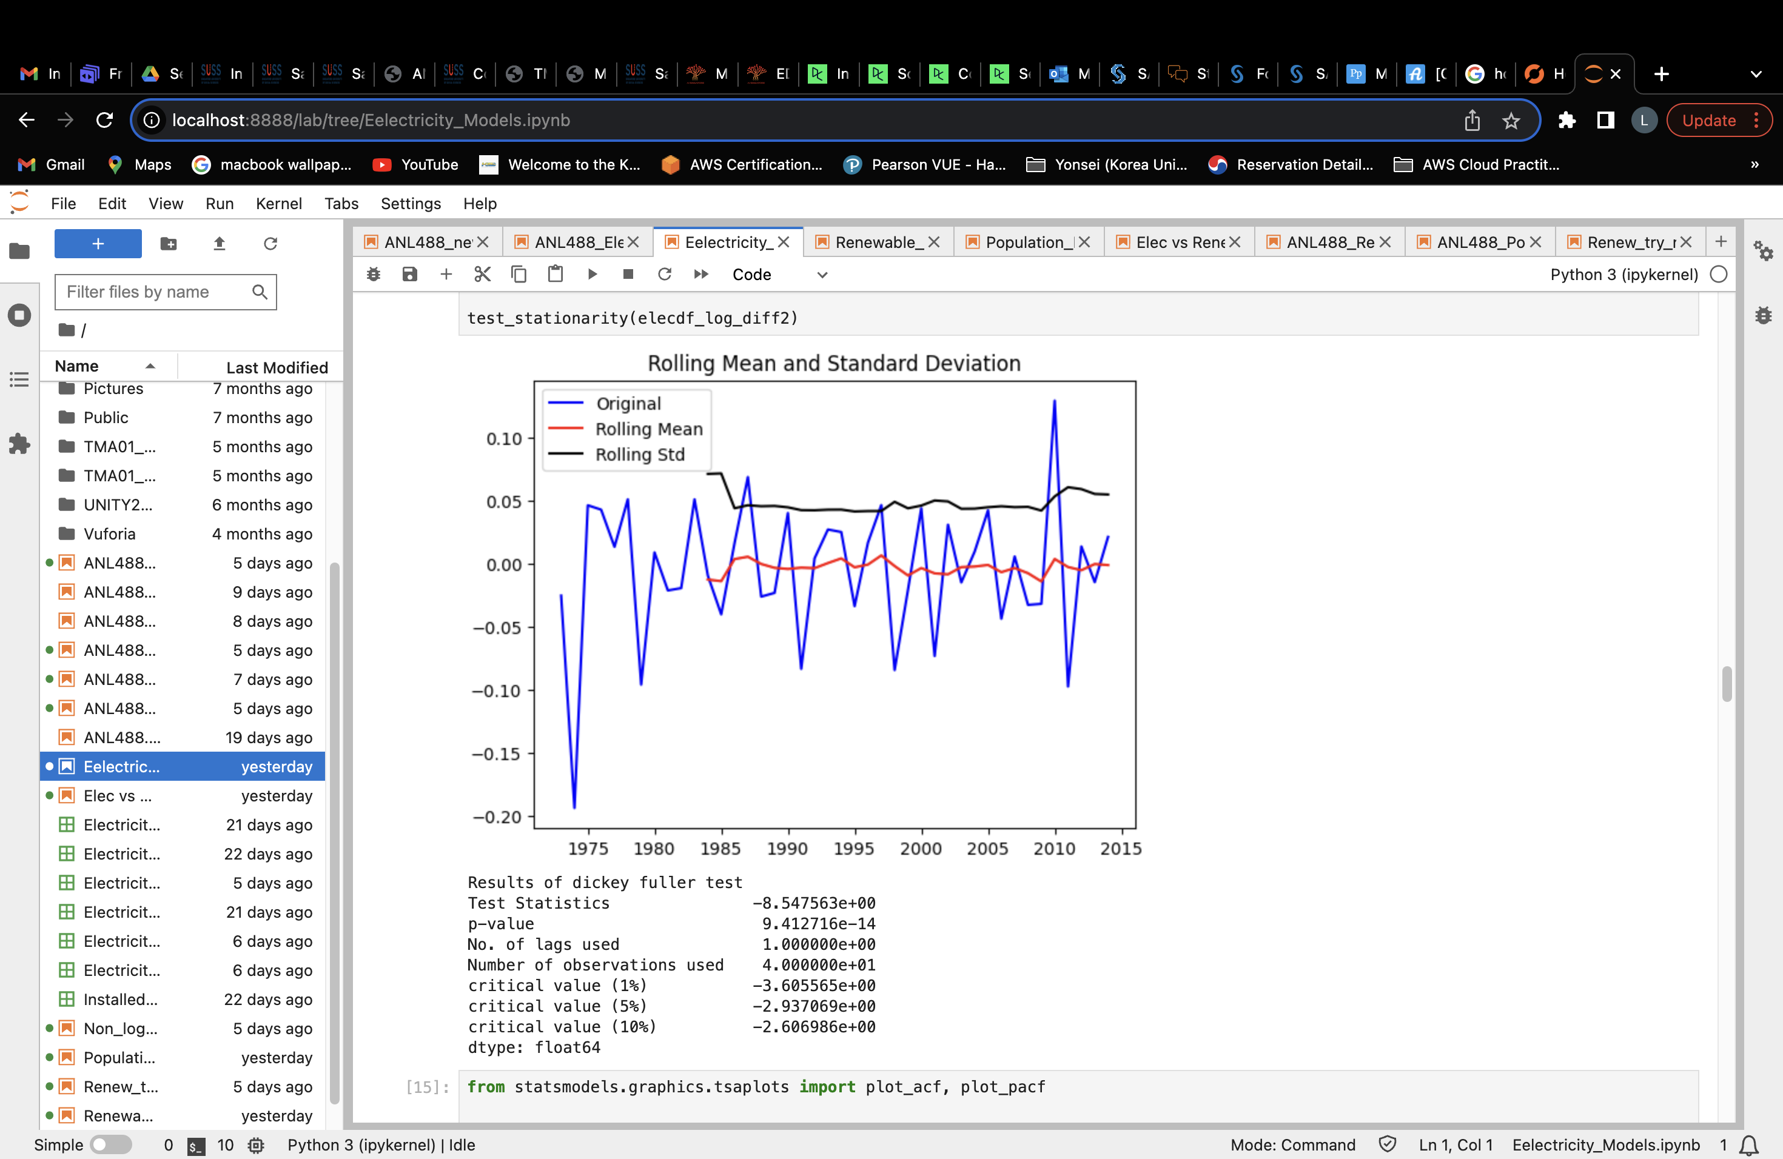
Electricity Consumption Dataset
4) Removing Trend (cont’d)
Performed differencing twice (2) to de-trend the dataset
After 1st order of differencing | After 2nd order of differencing

Slide 20
Electricity Consumption Dataset
5) Removing Seasonality
No Seasonality present
6) Ensure Stationarity
ADF p-value became 0.00 (2dp), which less than 0.05
Test statistics Value < Critical Values
Hence data is now stationary!

Slide 21
Renewable Electricity Generated Dataset
Handling missing or null values
Discarded 33 null values, data now ranges from 1986 to 2016
2) Check for stationarity
ADF p-value was 0.99 (2dp), not stationary
3) Linearize Trend
Performed Log transformation on the dataset
4) Removing trend
Performed differencing twice (2) to de-trend dataset
5) Removing Seasonality
No seasonality
6) Ensure stationarity
ADF p-value is now 0.00 (2dp), data is now stationary

Slide 22
Population Dataset
Handling missing or null values
There were no null / missing values, data still range from 1950 to 2022
2) Check for stationarity
ADF p-value was 1.00 (2dp), not stationary
3) Linearize Trend
Performed Log transformation on the dataset
4) Removing trend
Performed differencing twice (2) to de-trend dataset
5) Removing Seasonality
No seasonality
6) Ensure stationarity
ADF p-value is now 0.00 (2dp), data is now stationary

Slide 23
Models Used & Evaluation
5

Slide 24
Models Used
ARIMA Model
An Auto-Regressive Integrated Moving Average (ARIMA) model forecasts future values using forecast errors / past values.
Works best with stationary data without seasonality
ARIMA(p,d,q) values
Double Exponential Smoothing Model
An extension with trend smoothing component from Single Exponential Smoothing
Works best with data with trend and without seasonality
Notes:
Deducing which ARIMA model to use for each dataset
ARIMA(p,d,q) values -> Look at ACF and PACF of each dataset
Double Exponential Smoothing Model
Alpha (Smoothing level) -> 0.5 used
Beta (Smoothing trend) -> 0.5 used
Trend type (Additive/Multiplicative) -> additive used

Slide 25
Evaluation Factors
Mean Absolute Percentage Error (MAPE)
Measures model performance based on percentage of error between the actual values and predicted values
Smaller the MAPE value, the better the model performs
Square-Rooted Mean Squared Error (RMSE)
MSE measures the model’s mean squared difference between the actual and predicted values
RMSE is the square root of MSE
A smaller RMSE would suggest lesser error in the model

Slide 26

Electricity Consumption Dataset
Models | MAPE | RMSE
ARIMA (0,2,0) Model | 0.06 | 2.17
Double Exponential Smoothing (DES) Model | 0.08 | 2.65

Slide 27
Renewable Electricity Generation Dataset
Models | MAPE | RMSE
ARIMA (1,2,0) Model | 0.06 | 1.91
Double Exponential Smoothing (DES) Model | 0.14 | 4.04

Slide 28
Population Dataset
Models | MAPE | RMSE
ARIMA (0,2,0) Model | 0.08 | 1.79
Double Exponential Smoothing (DES) Model | 0.04 | 1.12

Slide 29
Champion Model for each Dataset
Dataset | Champion Model | MAPE | RMSE
Electricity Consumption Dataset | ARIMA (0,2,0) Model | 0.06 | 2.17
Renewable Electricity Generated Dataset | ARIMA(1,2,0) Model | 0.06 | 1.91
Population Dataset | Double Exponential Smoothing (DES) Model | 0.04 | 1.12

Slide 30
Modelling Results
6

Slide 31
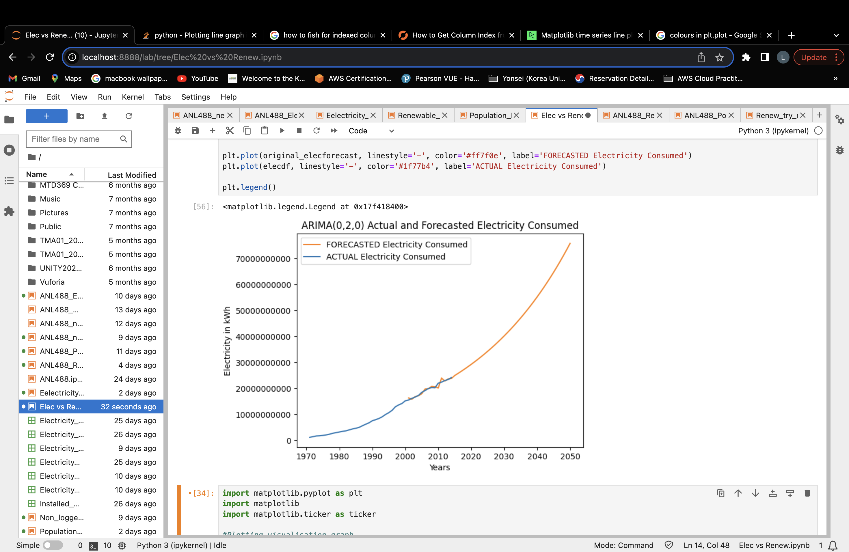
Electricity Consumption Dataset
Exponential Increase in electricity consumption levels.

Slide 32
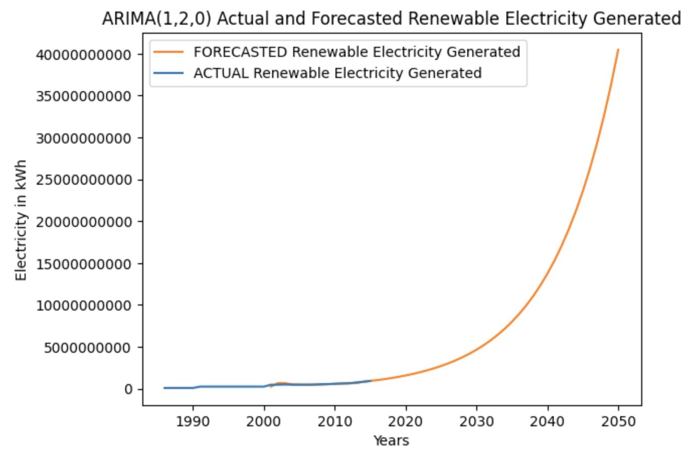
Renewable Electricity Generation Dataset
Steep exponential increase in renewable electricity generation in the future.
Steep increase from 2040 onwards

Slide 33
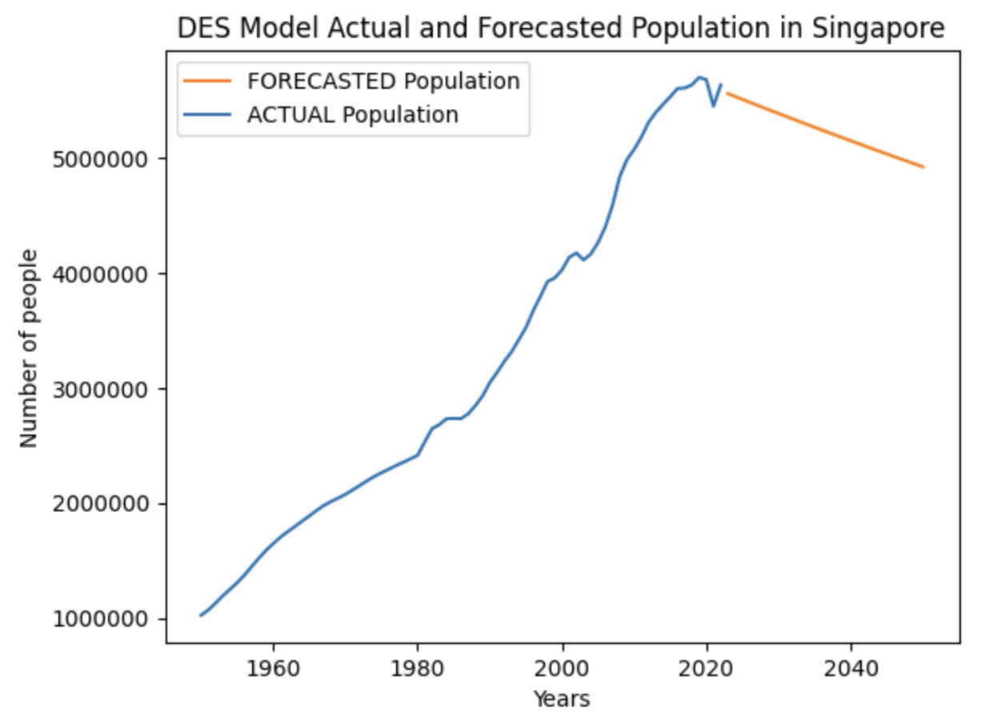
Population Dataset
Gradual Decrease in population

Slide 34
Electricity Consumption & Population
Population decreases gradually but Electricity consumption still increases
No matter population, electricity consumption will continue to increase nonetheless

Slide 35
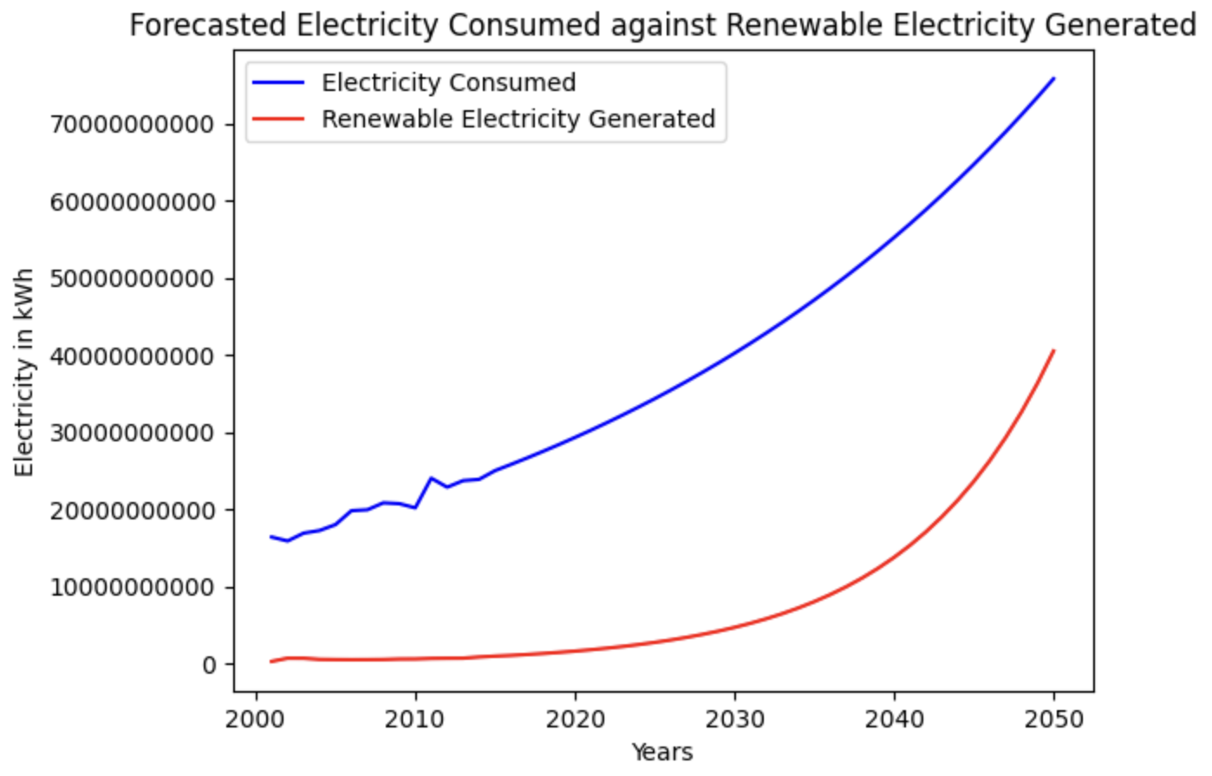
Electricity Consumption & Renewable Electricity Generated
AY2050
Exponential increase for both electricity consumption and renewable electricity generated.
Renewable electricity generated seems to have a steeper increase from 2040 onwards.
Hence, from current renewable electricity generation rate, Singapore will not be able to depend on renewable electricity generated as of year 2050.

Slide 36
As at 2050…
Percentage of forecasted renewables and Non-renewables from electricity consumed.

Slide 37
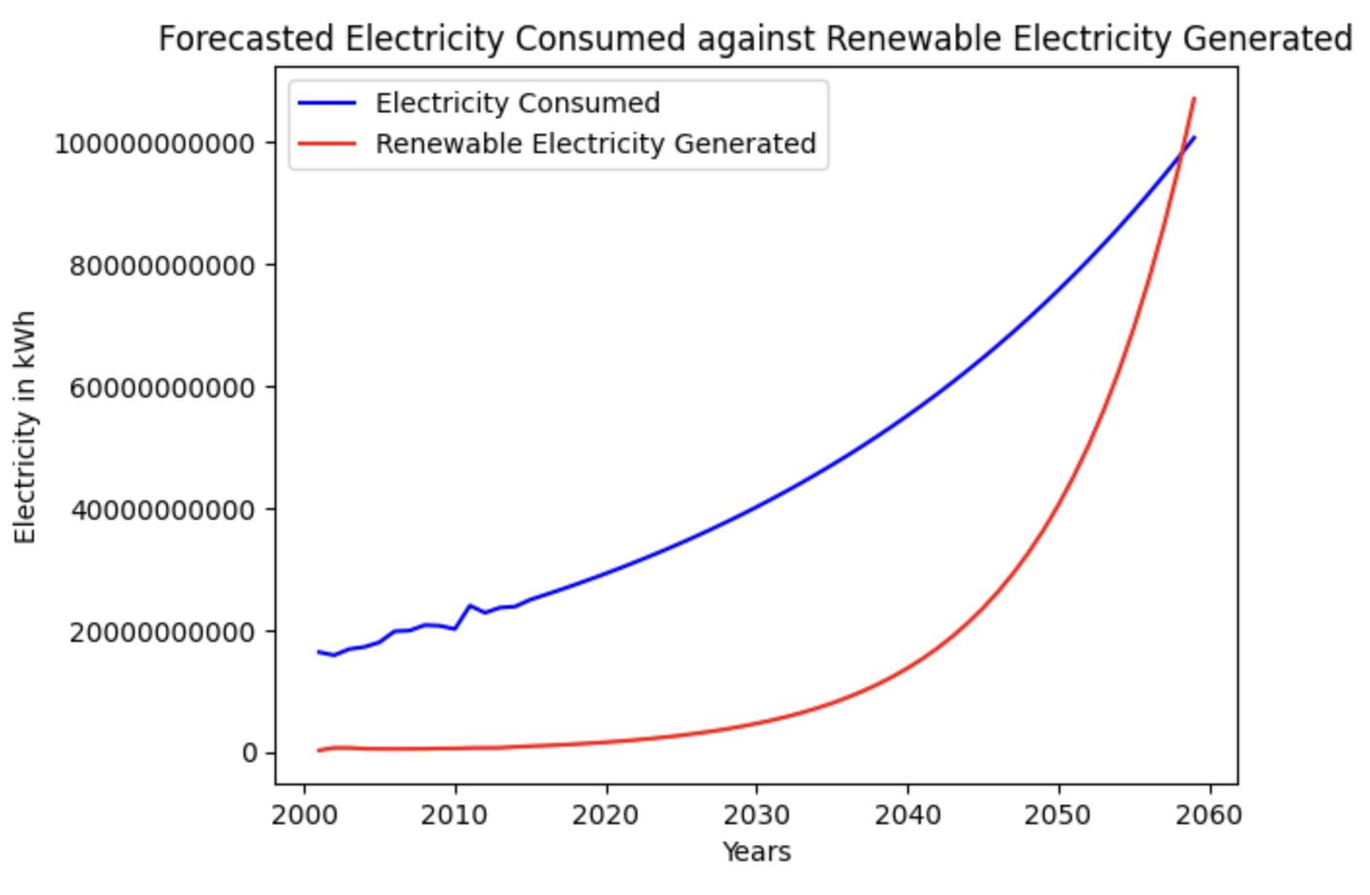
Electricity Consumption & Renewable Electricity Generated
AY2060
At year 2052, renewable electricity generated will be able to supplement >60% of the nation’s electricity consumption.
Thus, from year 2052 onwards, we can say that Singapore will be able to depend on renewable energy.

Slide 38
As at 2052…
Percentage of forecasted renewables and Non-renewables from electricity consumed.

Slide 39
Electricity Consumption & Renewable Electricity Generated
AY2060
At year 2059, electricity generated from renewables will surpasses electricity consumed.

Slide 40
Conclusion & Recommendations
7

Slide 41
In conclusion…
Population will likely decrease in the future.
Electricity consumption and renewable electricity generated will continue to increase in the future.
Although population is likely to decrease, electricity consumption will nonetheless, continue to increase.
Renewable electricity will be able to supply 53% of the nation’s electricity consumption at year 2050.
2 years later, Singapore will be able to depend on renewable electricity as it is able to supplement 62% of the nation’s electricity consumption level at year 2052.
At year 2059, Singapore’s renewable electricity generated will surpass the amount of electricity consumed in the same year.

Slide 42



Recommendations
Invest in research and development projects to leverage on technology to find more innovative ways to have more access points to renewable energy.
Continue to work with neighboring countries to import renewable energies and increase Singapore’s energy security for our future.
Continue to gradually Increase Solar Panel Installation around the island.
Notes:
https://www.straitstimes.com/singapore/environment/singapore-plans-to-import-30-of-energy-from-low-carbon-sources-by-2035
https://www.straitstimes.com/singapore/singapore-to-get-1gw-of-renewable-energy-from-cambodia-in-largest-electricity-import-to-date
https://www.straitstimes.com/singapore/environment/why-singapore-needs-to-import-electricity-and-other-energy-questions-answered
https://www.straitstimes.com/singapore/solar-panels-to-be-installed-at-1075-hdb-blocks-as-part-of-largest-tender-under-govt-solar-programme#:~:text=To%20date%2C%20about%203%2C300%20HDB,lifts%20are%20moving%20and%20braking.
https://www.channelnewsasia.com/commentary/singapore-renewable-energy-rooftop-buildings-solar-electricity-costs-2782796
Continue with their 4 switches strategy
- Use natural gas for the time being
- Use more solar panels
- Import more renewable sources
- Invest in R&D for low-carbon alternatives

Slide 43
Thank You!
Do you have any questions?

